Slide 1
Christmas is Coming!
Christmas is coming!
Christmas is coming!
Time to go to sleep
‘cause christmas is coming soon!
Now it’s time to go to bed.
That’s what everybody said.
Brush your teeth put PJs on
Wash your face and start to yawn
Now it’s time to go to bed
That’s what everybody said.
Now it’s time to go to sleep
Close your eyes and count some sheep
When you wake from this long night
Santa will have made his flights
Now it’s time to go to sleep
Close your eyes and count some sheep.
Sleep!

Slide 2
Sugar Plums
Can’t you see those lovely Sugar plums
dancing here, dancing there, dancing all around
Can’t you see those lovely Sugar plums
jumping here, jumping there, jumping up and down
Can’t you see those lovely sugar plums
Hopping here, popping there, never make a sound
Theyre so yummy in my tummy nice and gummy sugar plums!

Slide 3
JINGLE BELLS
Dashing through the snow
In a one horse open sleigh
Over the hills we go
Laughing all the way
Bells on bobtails ring
Making spirits bright
What fun it is to ride and sing
a sleighing song tonight!
Jingle bells
Jingle bells
Jingle all the way!
Oh what fun it is to ride
in a one horse open sleigh! Hey!
Jingle bells
Jingle bells
Jingle all the way!
Oh what fun it is to ride
in a one horse open sleigh! Hey!

Slide 4
OH CHRISTMAS TREE SILENT NIGHT
Oh Christmas tree, Oh christmas tree
How lovely are your branches
Oh Christmas tree, Oh christmas tree
How lovely are your branches
Your boughs so green in summertime
Stay bravely green in winter time
Oh Christmas tree, Oh christmas tree
How lovely are your branches
Silent Night
Holy night
All is calm
All is bright
Round yon virgin mother and child
Holy infant so tender and mild
Sleep in heavenly peace
Sleep in heavenly peace

Slide 5
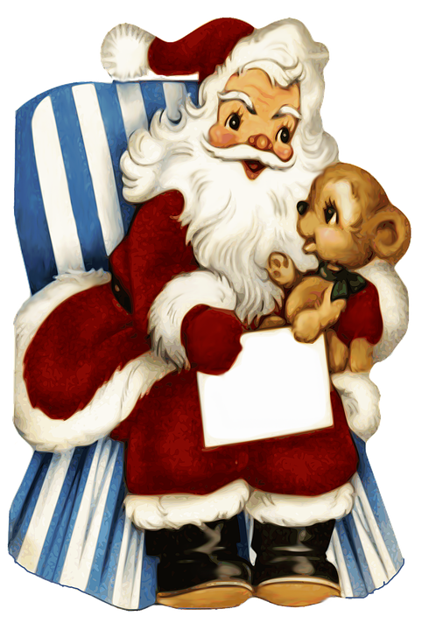
Saint
Nick
at
Night
Jolly old St. Nicholas,
Lean your ear this way!
Don't you tell a single soul,
What I'm going to say;
Christmas Eve is coming soon,
Now, you dear old man,
Whisper what you'll bring to me:
Tell me if you can.
When the clock is striking twelve,
When I'm fast asleep,
Down the chimney broad and black, With your pack you'll creep.
All the stockings you will find
Hanging in a row;
Mine will be the shortest one,
You'll be sure to know.
Have you heard about Saint Nick at night?
Traveling all across the world in flight
Carrying a great big sack
And delivering toys in no time flat!
Christmas eve he will be at our house
Keeping very quiet as a mouse
Landing right upon your roof
In the morning look for proof!

Slide 6
Reindeer on the Roof!
(reindeer on the roof) Wake up I think I hear
(they’re on the roof) Santa and his 8 reindeer
(they’re on the roof) I knew they would arrive
(they’re on the roof) I’m the luckiest kid alive
(I said the)
Reindeer the reindeer are on the roof!
They’re on the roof!
I hear them prancing
I hear the dancing
They’re so entrancing
Reindeer on the roof
I hear their hoof beat
It’s sounding so sweet
Theyre here on my street
Reindeer on the roof
(reindeer on the roof) Wake up I think I see
(they’re on the roof) lots of presents just for me
(they’re on the roof) they’re loaded up the sleigh
(they’re on the roof) getting ready for this big day
(I said the)
Reindeer the reindeer are on the roof!
They’re on the roof!

Slide 7
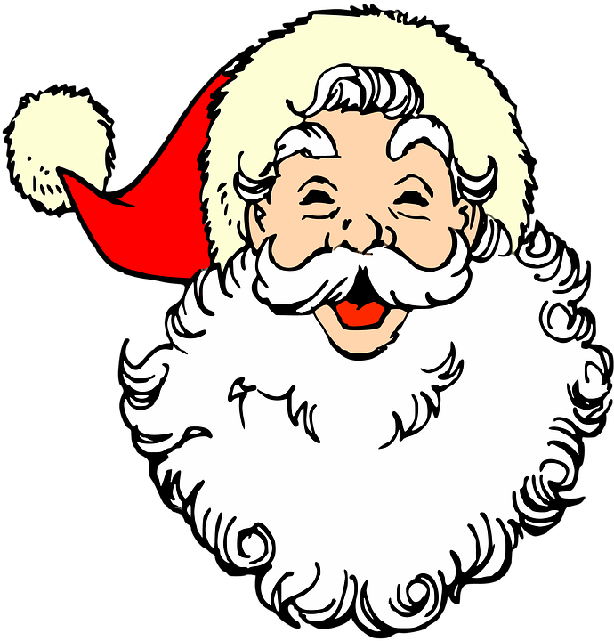
When I look at Santa
When I look at santa what do I see?
A smiling face with twinkling eyes
gazing down at me
When I look at santa what do I see?
A gentle touch a joyful heart,
what I want to be.
When I look at santa what do I know?
That he is giving he is kind,
everywhere he goes.
When I look at santa what do I know?
That he can teach me many things,
help my heart to grow.
Santa is generous,
Santa is good.
Santa loves everyone
just like we should!

Slide 8
UP ON THE HOUSETOP
Up on the housetop reindeer pause
Out jumps good old santa claus
Down through the chimney with lots of toys
All for the little ones christmas joys
(high and low) Ho ho ho! Who wouldn’t go?!
(high and low) Ho ho ho! Who wouldn’t go?!
Up on the housetop click click click!
Down through the chimney with good saint Nick!

Slide 9
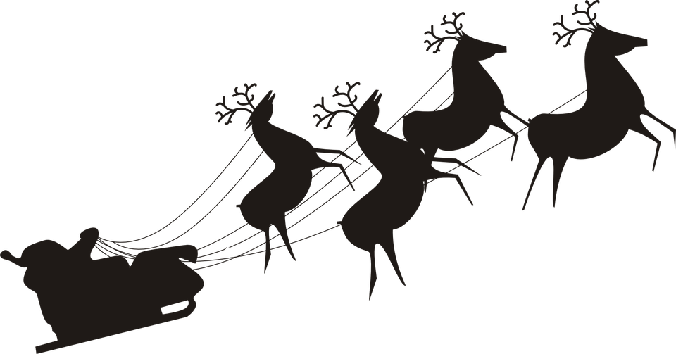
To All A Good Night
Happy Christmas to all
Happy Christmas to all
And to all a good night
Happy Christmas to all
Happy Christmas to all
And to all a good night
Make my christmas happy
Make my christmas bright
May santa and his sleigh come this holiday
And fill my stocking up tight
Make my christmas happy
Make my christmas bright
We all heard him say as he went on his way
Happy christmas to all and to all a good night.
Make my christmas merry
Fill it full of joy
May each and everyone
Have a ton of fun
Make it a day to enjoy.
Make my christmas merry
Make my christmas bright
Good things come to you in all that you do
Happy christmas to all and to all a good night
Happy christmas to all and to all a good night!

